Slide 1
Ranger 3.0 Troubleshooter
WMD Related Errors
Available Version
Ver 1.0

Slide 2
Ranger 3.0 Troubleshooter
Transmission/WMD Related Error
Ver.1.0
Start
Note:
Run the slide and click on buttons, videos or hyperlinks as necessary. DO NOT USE ARROW KEYS
In case of incorrect selection, rerun the slide or go to previous slide
FlowChart Reference

Slide 3
Ranger 3.0 Troubleshooter
Error Description:
Follow this page if following is happened in BoT
Either of the Wheel is stuck or not moving in BoT
BoT is unable to perform NFS
Either of the Wheel is vibrating
Next
Preview
Next

Slide 4
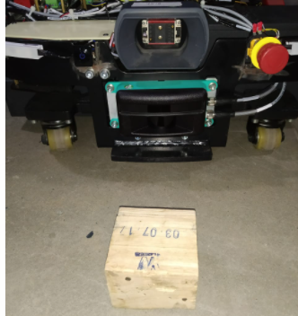
Ranger 3.0 Troubleshooter
Step 0 : Check if anything Infront of Ranger within 20 cm in moving direction.
Object
Step1. Did you find any object Infront of Ranger? If yes then remove it.
Step2. Is your error resolved in Ranger ?
YES
NO
Click on your answer
Preview
Next

Slide 5

Ranger 3.0 Troubleshooter
Now perform NFS as mentioned in support link document.
SN | Support Link
1 | Procedure to Perform NFS
Is your Error get resolved?
YES
NO
Preview
Next

Slide 6
Ranger 3.0 Troubleshooter
Move the wheel in opposite direction through NFS as mentioned in support link document.
SN | Support Links
1 | Procedure to Perform NFS
Is your Error get resolved?
YES
NO
Preview
Next

Slide 7
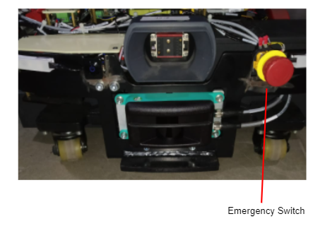
Ranger 3.0 Troubleshooter
Press and released the both emergency button as mentioned in support link document.
Wait for 5 sec and again move the wheel through NFS and check if the issue is released.
SN | Support Links
 | Procedure to Perform NFS Procedure for Checking Both Emergency Button
Did error get resolved?
YES
NO
Preview
Next

Slide 8
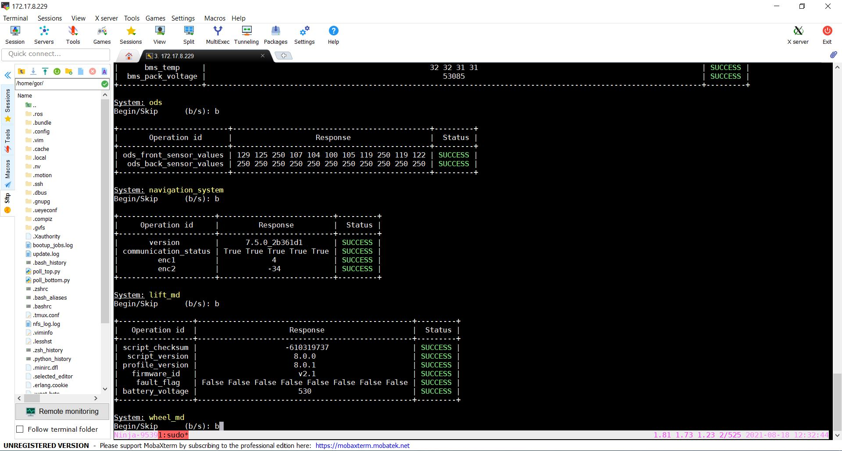
Ranger 3.0 Troubleshooter
Perform LMD and WMD diagnostic as mentioned in support link document.
SN | Support Links
1 | Procedure For Diagnostics
Did WMD diagnostic test get passed? Or error is fixed ?
YES
NO
Preview
Next

Slide 9
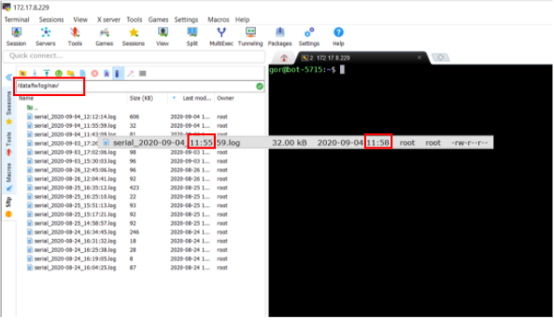
Ranger 3.0 Troubleshooter
Check if LMD is powered ON by reading battery voltage in navigation log as mentioned in support link document. (Battery voltage Range: 48V-58V)
Restart the bot, Perform NFS and check if the issue get resolved.
SN | Support Links
1 | Procedure for Checking Battery Voltage in Navigation Log
Is your issue is resolved ?
YES
NO
Preview
Next

Slide 10
Ranger 3.0 Troubleshooter
Check if any faults reported in VAR 5 for WMD in navigation log as mentioned in support link document.
SN | Support Links
1 | Procedure for Checking Unable to read VAR 5 Error in Navigation Log
Did you found the VAR 5 Error in Logs ?
YES
NO
Preview
Next

Slide 11
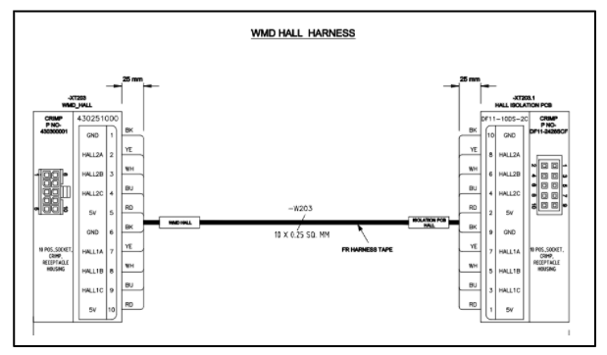
Ranger 3.0 Troubleshooter
Check IMB to WMD RS232 communication line as mentioned in support link document
Restart the bot, Perform NFS and check if the WMD issue get resolved.
SN | Support Links
1 | Procedure for Checking IMB to WMD RS232 Communtion Line
Did issue get resolved?
YES
NO
Preview
Next

Slide 12
Ranger 3.0 Troubleshooter
Check if Value of VAR_5 is 1 reported in navigation log as mentioned in support link document.
SN | Support Links
1 | Procedure for Checking Value of VAR_ 5 in Navigation Log
Did Value of VAR 5 is 1 reported in navigation log?
YES
NO
Preview
Next

Slide 13
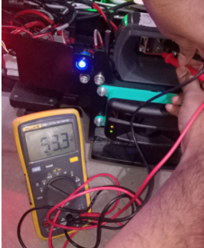
Ranger 3.0 Troubleshooter
Check physical Battery Voltage (working range 48V to 58V) on staubli connector with the help of Multi-meter..
Was battery voltage correct?
YES
NO
Preview
Next

Slide 14
Ranger 3.0 Troubleshooter
Again perform NFS and WMD diagnostic as mentioned in support link document.
SN | Support Links
 | Procedure to Perform NFS Procedure For Diagnostics
Did issue get resolved?
YES
NO
Preview
Next

Slide 15
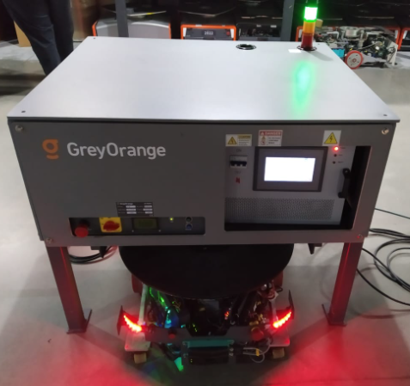
Ranger 3.0 Troubleshooter
Again charge the bot full and check if issue is get resolved. By doing BoT restart.
Did issue get resolved?
YES
NO
Preview
Next

Slide 16
Ranger 3.0 Troubleshooter
Check if Value of VAR_5 is 2 reported in navigation log as mentioned in support link document.
SN | Support Links
1 | Procedure for Checking Value of VAR_ 5 in Navigation Log
Did Value of VAR 5 is 2 reported in navigation log?
YES
NO
Preview
Next

Slide 17
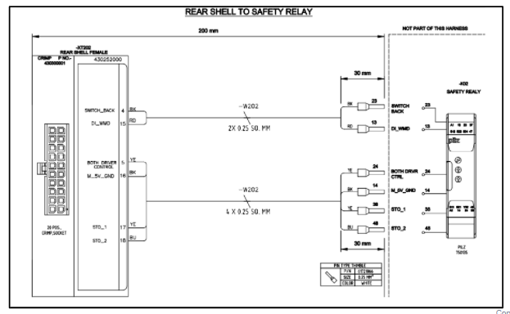
Ranger 3.0 Troubleshooter
Check safety stop output coming from safety system to WMD as mentioned in support link document.
SN | Support Links
1 | Procedure for Checking Safety Stop Output from Safety System to WMD
Did Safety stop output line correct?
Preview
YES
NO
Next

Slide 18
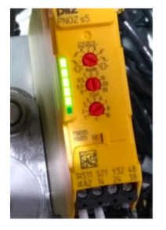
Ranger 3.0 Troubleshooter
Check safety Relay status as mentioned in support link document.
SN | Support Links
1 | Procedure for Checking Safety Relay status
Did Safety Relay status correct?
YES
NO
Preview
Next

Slide 19
Ranger 3.0 Troubleshooter
Check if Value of VAR_5 is 3 reported in navigation log as mentioned in support link document.
SN | Support Links
1 | Procedure for Checking Value of VAR_ 5 Value is 3 in Navigation Log
Was Value of VAR_5 is 3?
YES
NO
Preview
Next

Slide 20
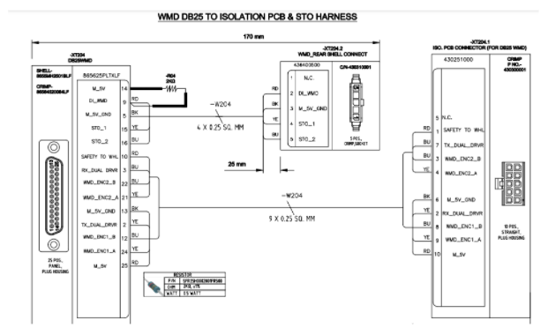
Ranger 3.0 Troubleshooter
Check Wheel motor encoder connection to WMD as mentioned in support link document.
Again run the wheel through NFS and check if the issue is resolved.
SN | Support Links
1 | Procedure for Checking Wheel Motor Encoder Connection to WMD
Did WMD issue get resolved?
YES
NO
Preview
Next

Slide 21
Ranger 3.0 Troubleshooter
Check if Value of VAR_5 is -1 reported in navigation log as mentioned in support link document.
SN | Support Links
1 | Procedure for Checking Value of VAR_ 5 Value is -1 in Navigation Log
Was Value of VAR_5 is -1?
YES
NO
Preview
Next

Slide 22
Ranger 3.0 Troubleshooter
Restart the bot, press and release the emergency button as mentioned in support link document.
Again run the wheel through NFS and check if the issue is resolved.
SN | Support Links
1 | Procedure for NFS
Did your issue get resolved?
YES
NO
Preview
Next

Slide 23
Ranger 3.0 Troubleshooter
Check if Value of VAR_5 is 99 reported in navigation log it means there is no fault in WMD as mentioned in support link document.
SN | Support Links
1 | Procedure for Checking VAR_5 Value in Nav Log
Was Value of VAR_5 is 99?
YES
NO
Preview
Next

Slide 24
Ranger 3.0 Troubleshooter
If VAR_5 value is 99, it means this is not WMD related issue. It may another issue. Check other relevant troubleshooting guide for resolution of error.
Done
Preview
Next

Slide 25
Ranger 3.0 Troubleshooter
If previous steps could not resolve the issue, create a site support ticket for resolution of error.
Done
Preview
Next

Slide 26
Ranger 3.0 Troubleshooter
END OF TROUBLESHOOT
Begin Again

